Slide 1


Slide 2



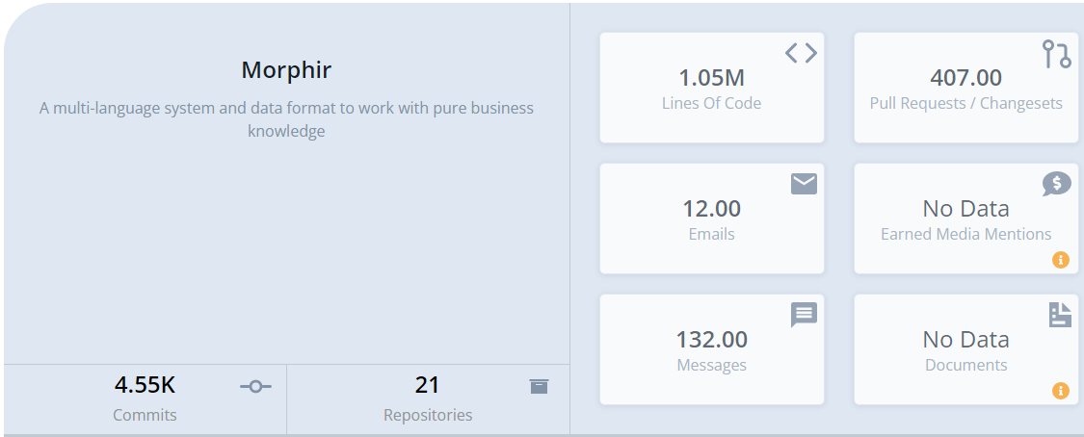
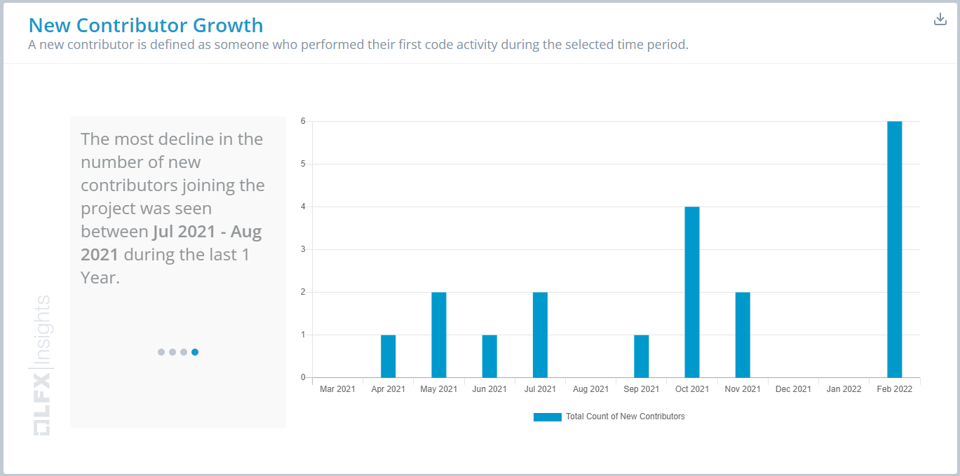


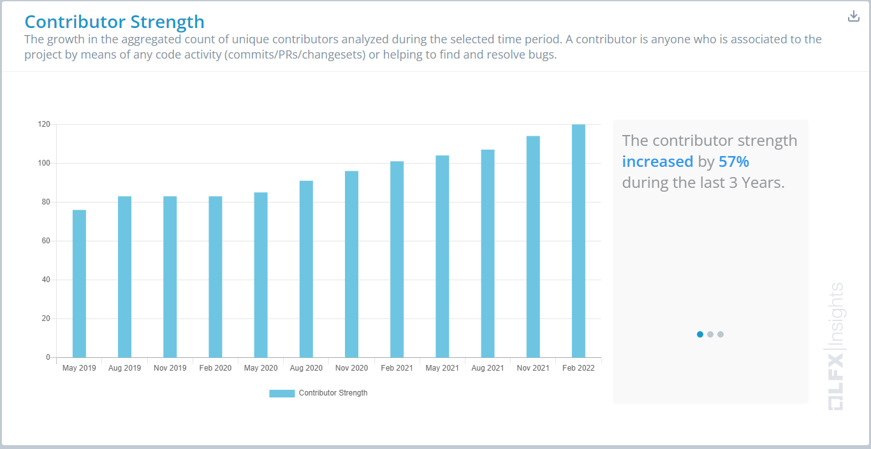
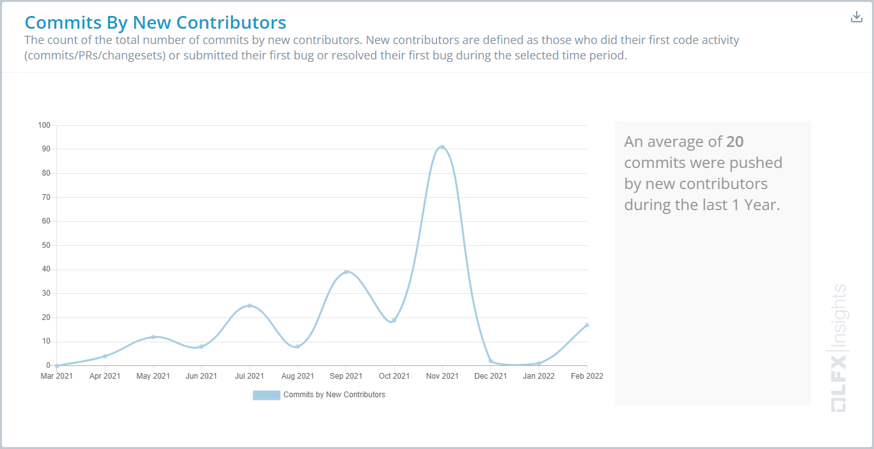
project
Stephen Goldbaum
Morgan Stanley Executive Director

Slide 3
Motivation
Industry-wide Transformation
More automation
Faster tech advances
More citizen involvement
Increased Transparency
Regulatory requirements
Easy to investigate and understand
Audits
Ensure correctness
Be Better
Work faster
Reduce risk
Increase efficiency
Open Source
Access to talent
Smoother execution
Makes good business sense

Slide 4
Motivation
Eliminates technical debt risk
Refactoring code libraries is often a harmful and time sensitive issue for businesses, Morphir ensures the standards introduced from input eliminate delays at deployment.
Ensures correctness
Certifying that specified functions behave as intended from input to output is assured through the library/ toolchain.
Increase agility
Adaptability and usability are key concepts of the Morphir framework, business logic can now move with the code, be easily understood and adopted in an ever-developing ecosystem.
Disseminates knowledge through automation
Morphir automated processing helps disseminate information which otherwise may not be understood or shared at all. a useful tool when bringing elements of business logic to conversation outside its immediate audience (i.e., developers)

Slide 5
Where Morphir Fits
Business Logic Frontends
Backend Targets
Programming Language (Elm, Bosque…)
Code (Scala, TypeScript…)
Domain specific languages
Data Processing
(SQL, Spark…)
GUI tools and more…
Other…

Slide 6



The Morphir Experience
Inefficient
Write spec
Study spec
Design code
Implement code
Document code
Test
Redo as needed
Integrate (data dictionary, etc.)
Deploy
Redo as needed
Efficient
Collaborate on spec using Morphir
Test
Generate
Deploy

Slide 7
Sharing Business Logic
Creation
Execution
Knowledge
Integration

Slide 8
Morphir Ecosystem Theme
We put knowledge into our code.
We should get knowledge out of it, too.

Slide 9
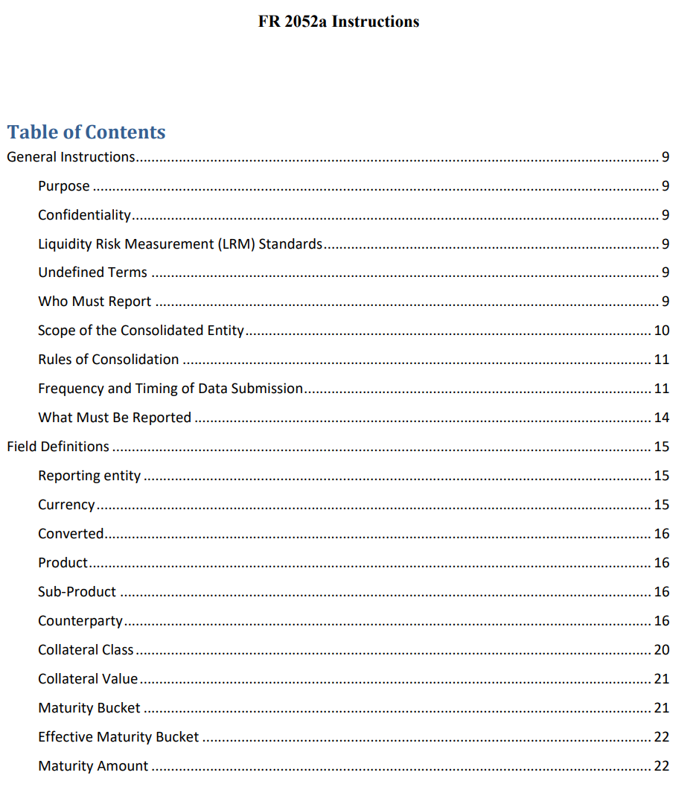
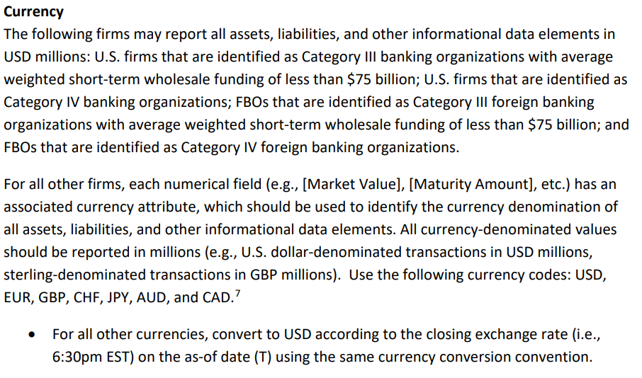
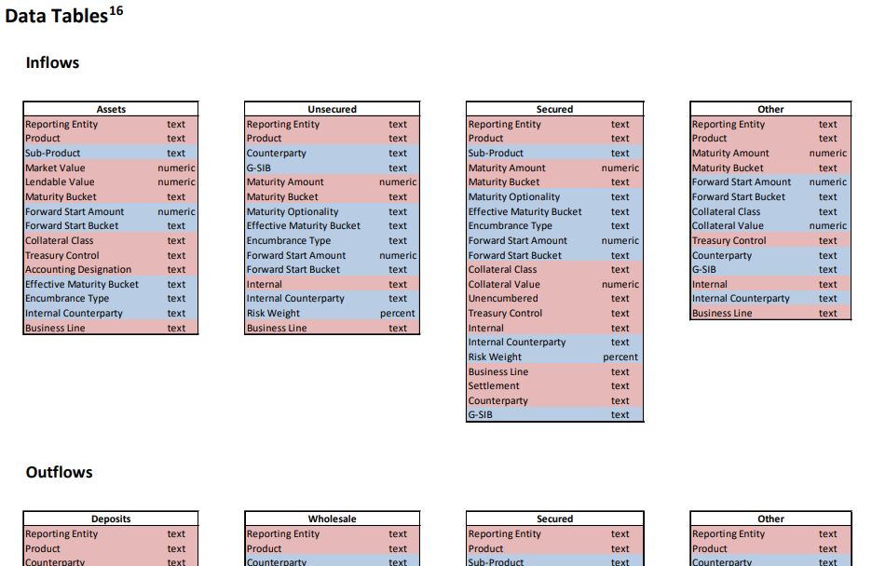
Creation: Spec

Slide 10
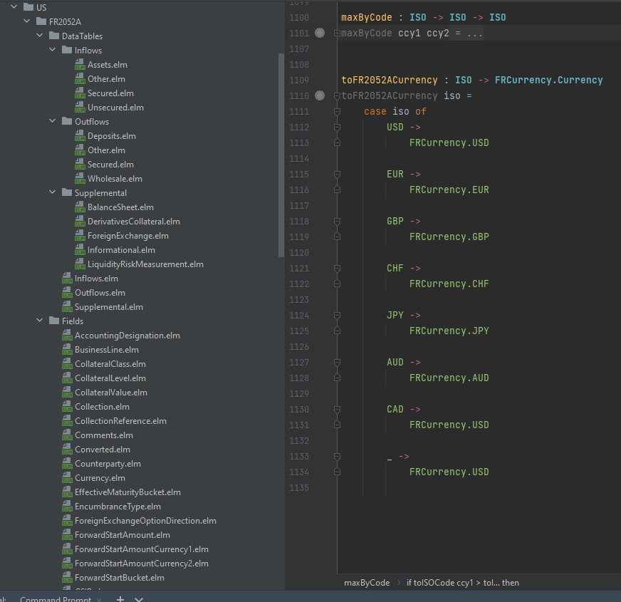
Creation: Spec = Code / Code = Spec

Slide 11
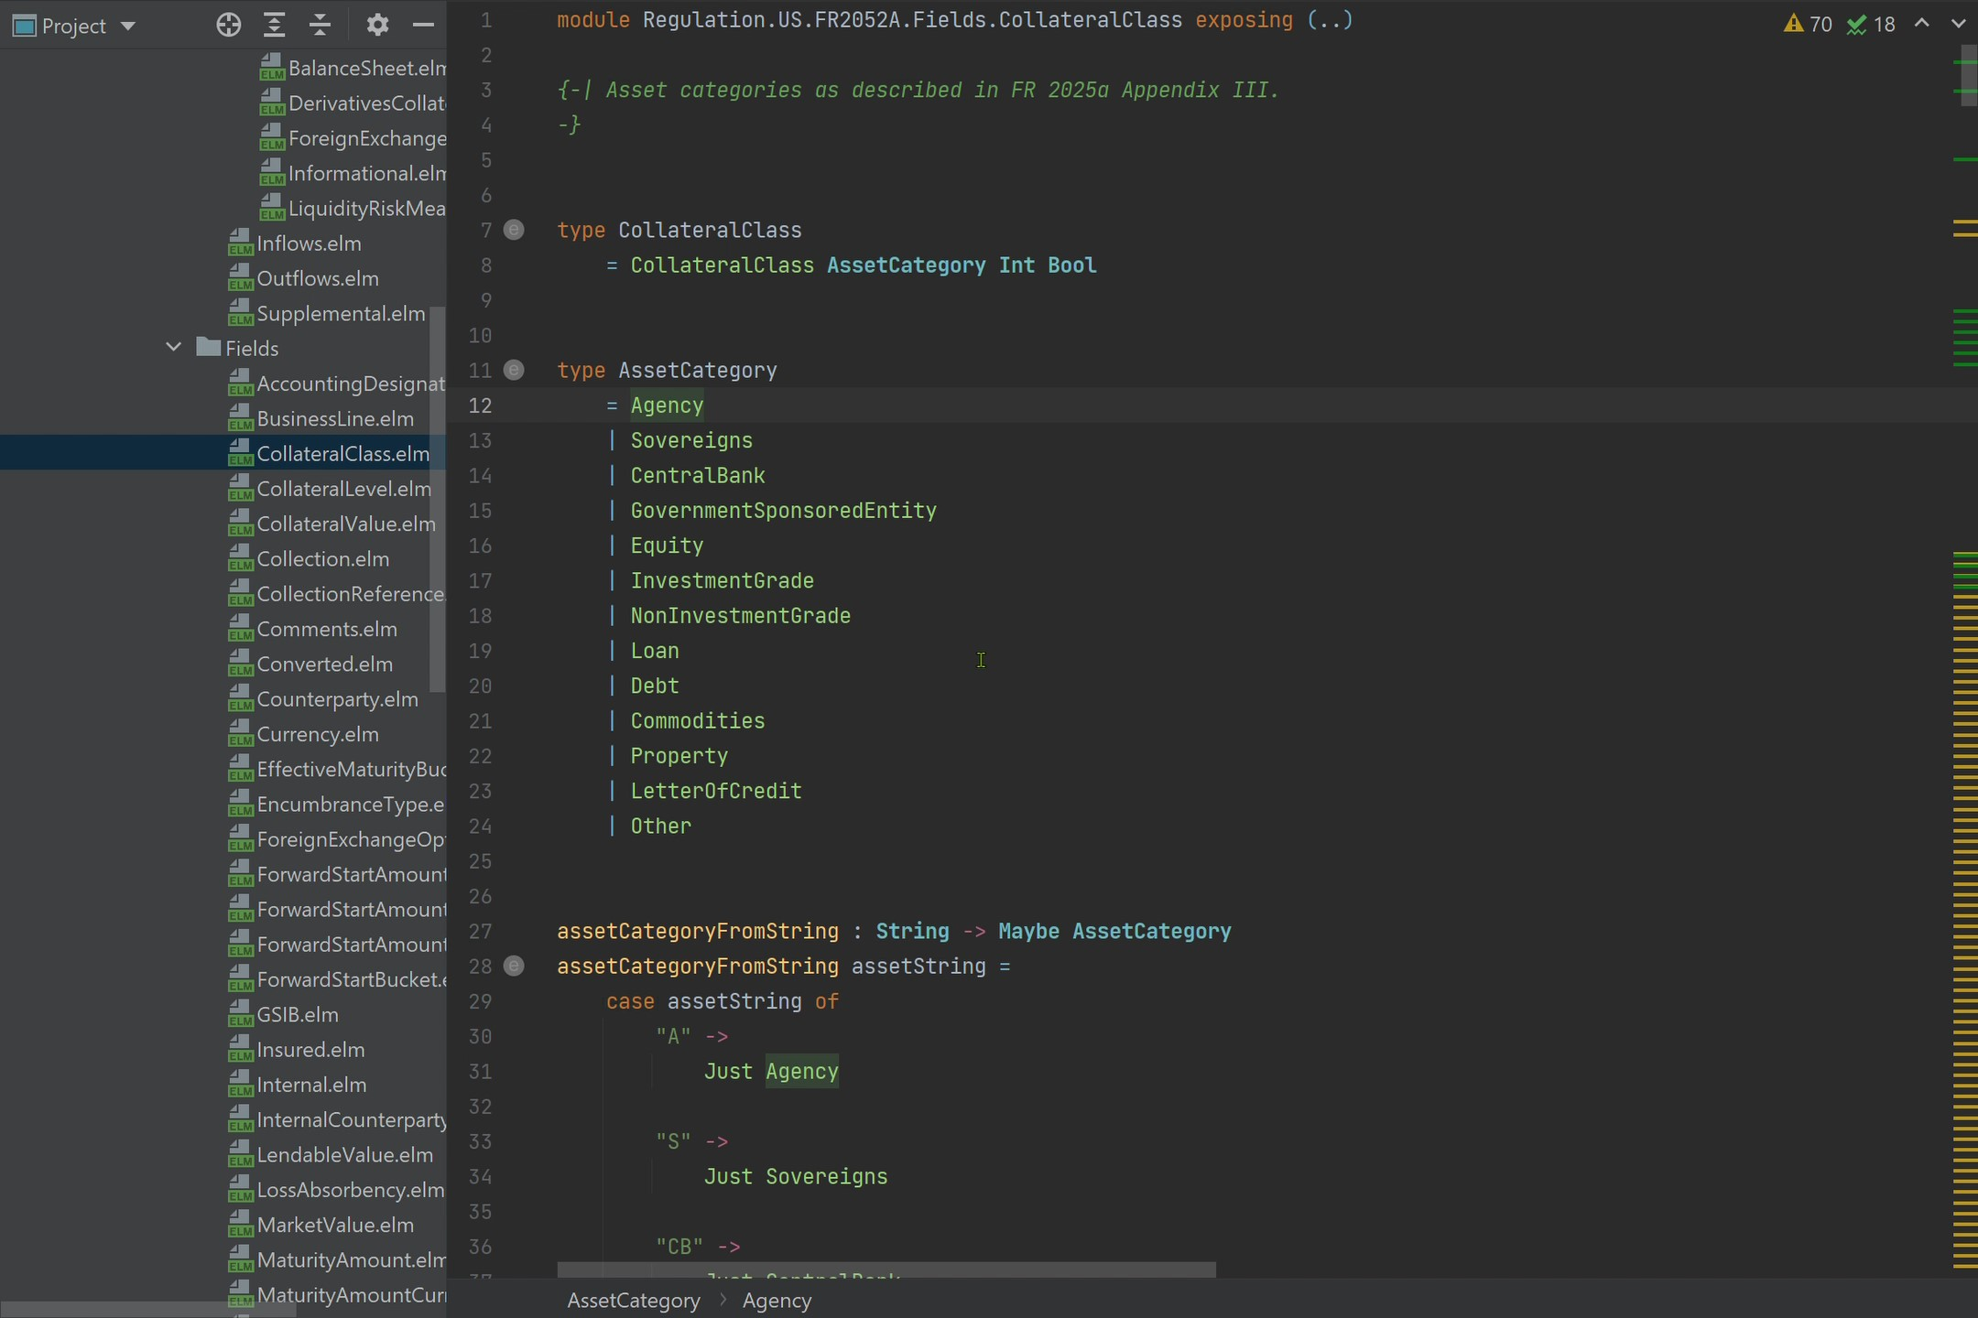
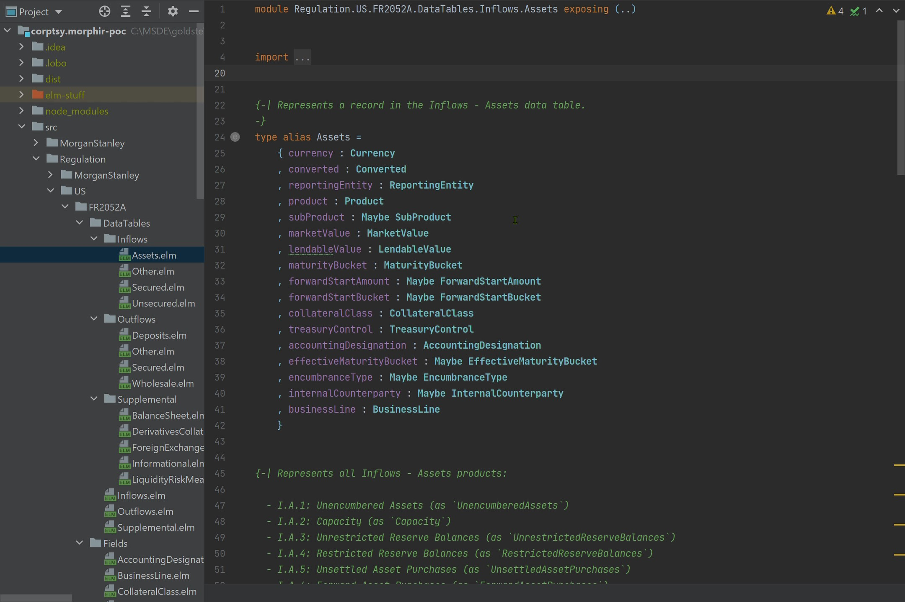
Creation: Elm
Open-source programming language

Slide 12










Creation: Open-source
Core Morphir
Elm
DSL
Open-source Community
Elm
Bosque
Legend
Scala
Rosetta
TypeScript
Bosque Programming Language

Slide 13
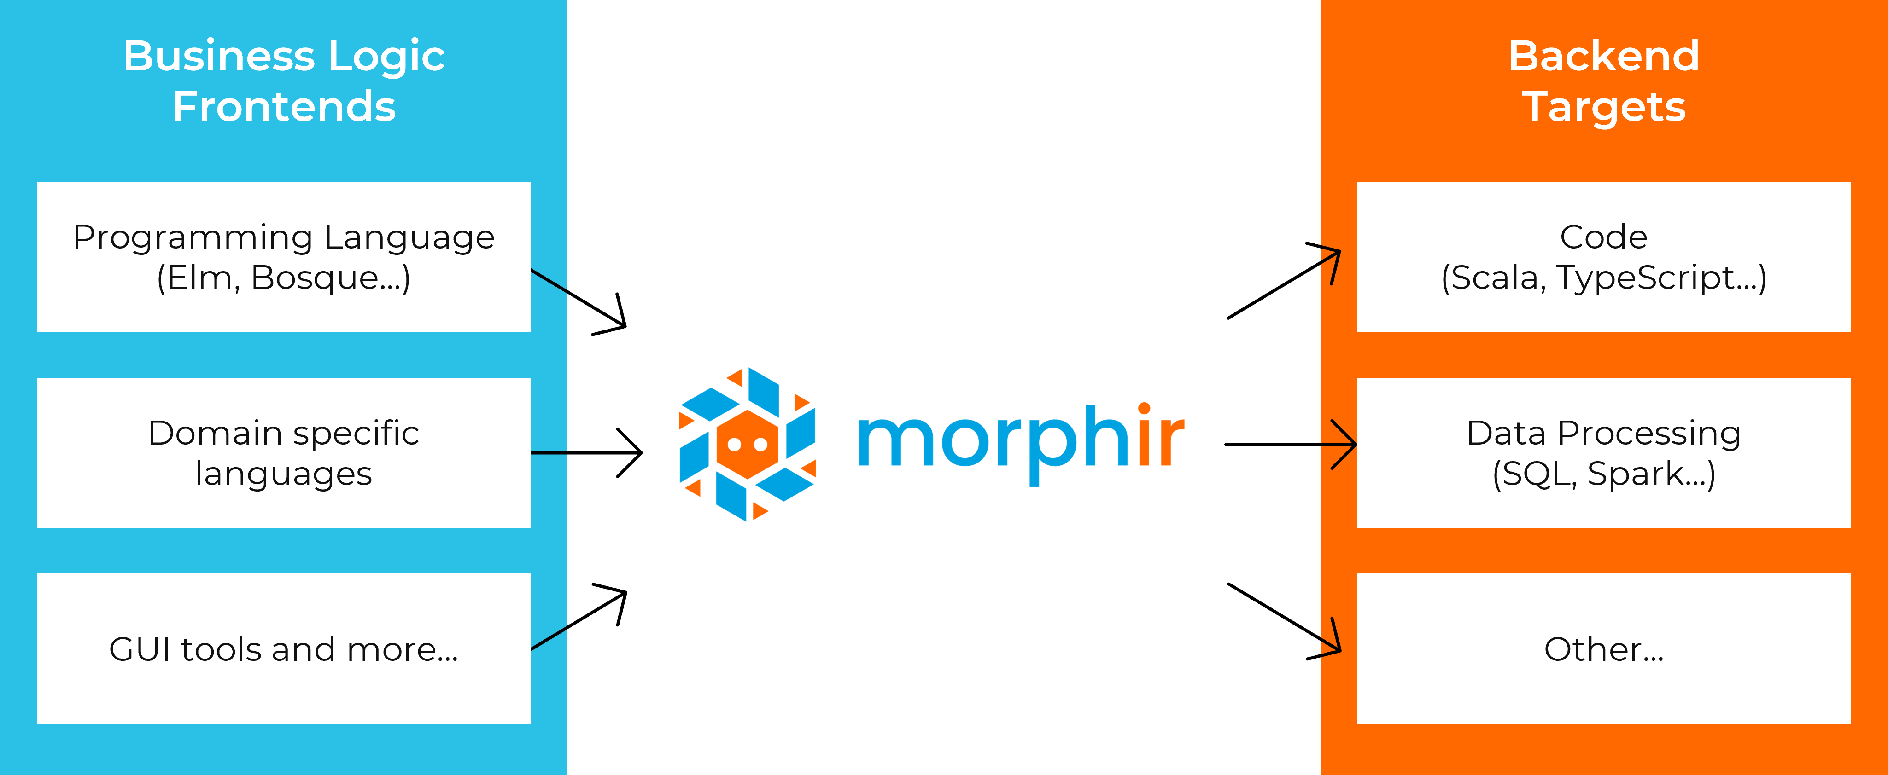
Creation: Other Open-source Ideas
SQL
ETL
DAGS (Spark, BEAM, Jet, etc.)
F#/OCaml
Rules engine DSLs
Excel
Low Code/No Code
…
There’s business logic in all of these. If we can extract it, we can do great things.

Slide 14
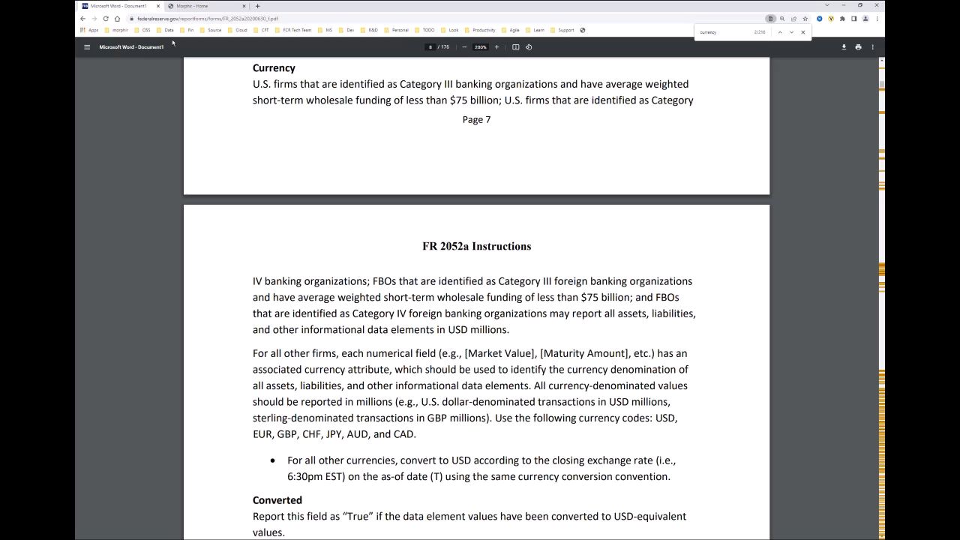
Quality: Interactive Tools

Slide 15
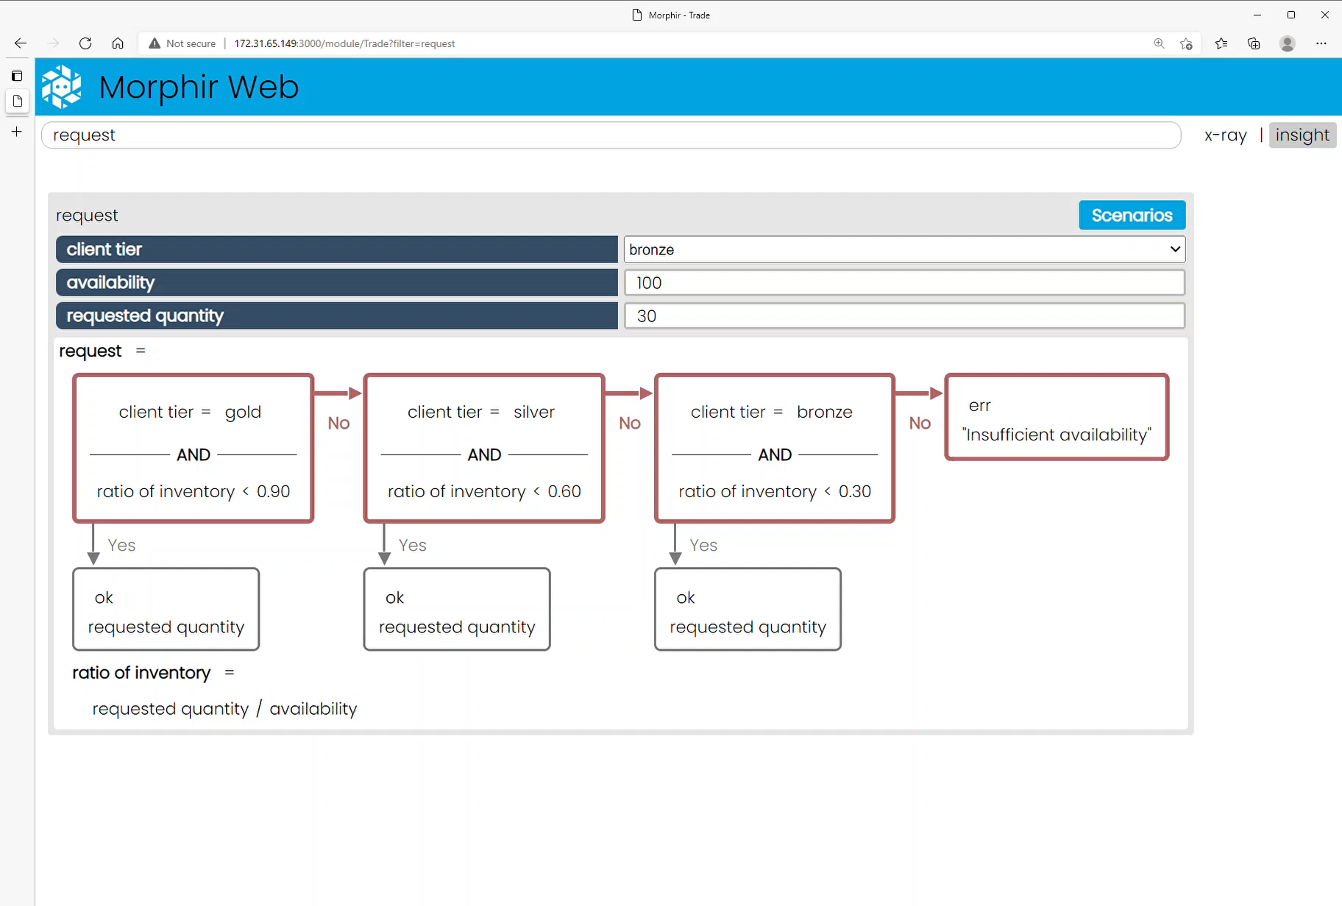
Knowledge: Audit
Why’d it do that?

Slide 16
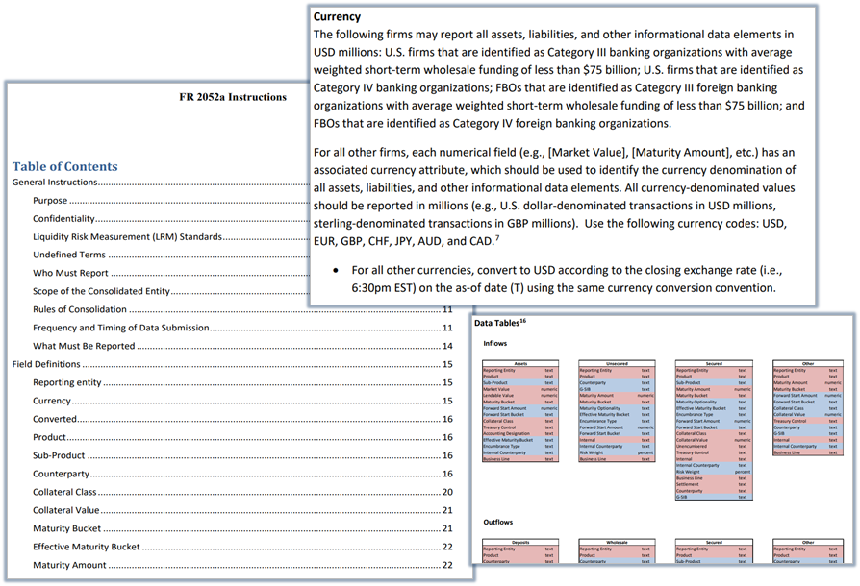
Knowledge: Pure Business Logic

Slide 17
Anti-knowledge: Impure Business Logic
Notes:
Fragmentation
Business users can’t understand from code
Neither can we!
Forensics exercise

Slide 18
Knowledge: Pure Business Logic

Slide 19

Quality & Knowledge
Core Morphir
100% Pure business logic
Insight
Test
Audit
Graph
Open-source Community
Elm/functional compiler
Bosque verification
Legend/Morphir/Bosque integration project
POPL 2022 Conference and Paper
Bosque Programming Language

Slide 20
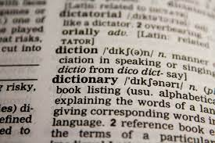
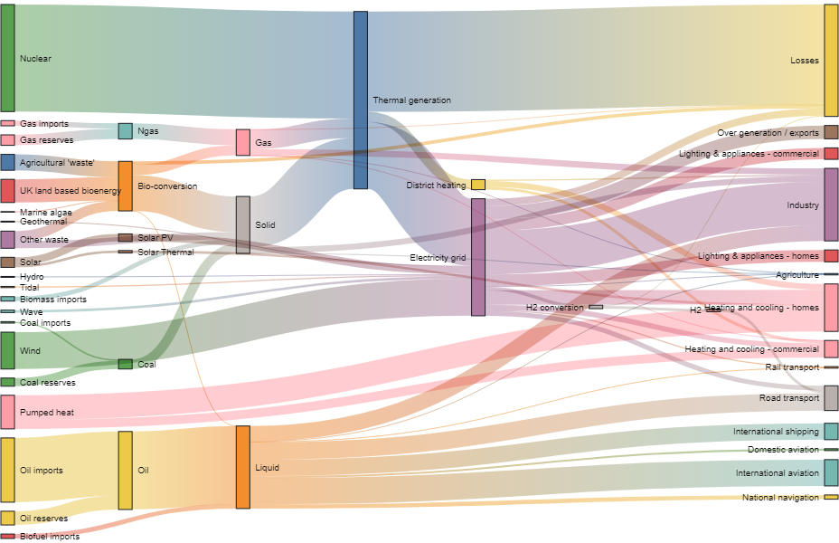
Integration
Data Dictionary
Data Lineage
Data Quality

Slide 21
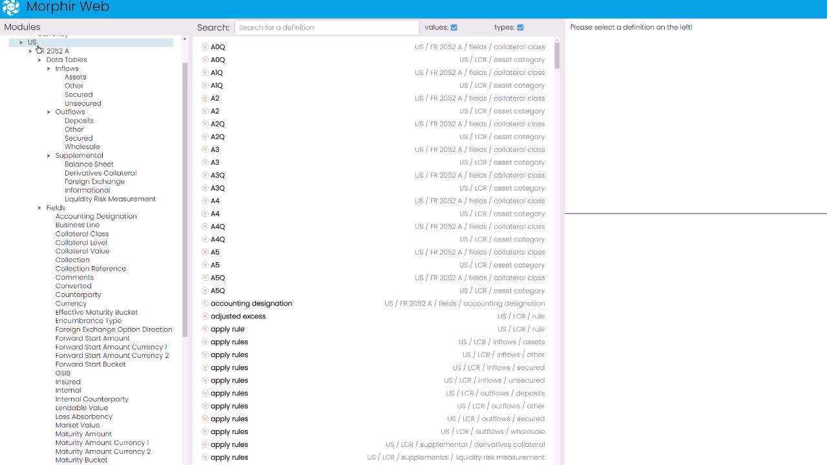
Integration

Slide 22





Execution
Core Morphir
Scala/JVM
JavaScript
Interpreted
Spring
Open-source Community
Dapr
Spark
…

Slide 23
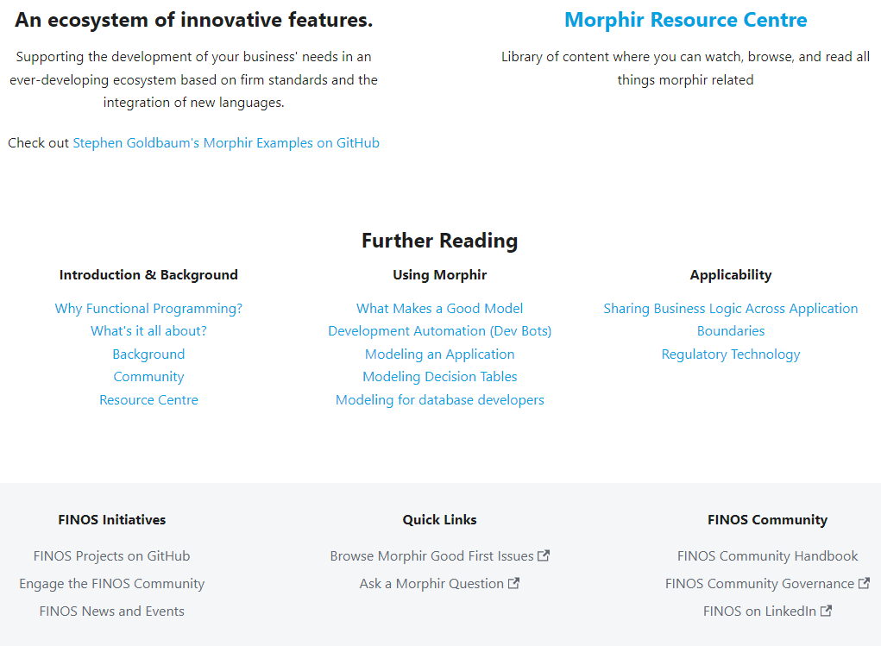
Open-source Success
Incredible partnerships
Incredible potential
Roadmap
Execution
Spark
Microservice
Creation
Scala and more…
Quality
More insight
More Bosque verifier
Integration
Data Management & Data Quality
Ontologies & semantic
Get Involved
Your creativity

